Slide 1

HOME AUTOMATION
MyHome
BY :
NARENDER KESWANI [24] | AMARDEEP KASHYAP [23]
SHAMMAS KHAN [26] | SHIVAM KSHIRSAGAR [29]
UNDER THE GUIDANCE OF :
PROF. MONA DESHMUKH

Slide 2

PURPOSE
MyHome
The main reason for choosing this project is to make life easier of human beings. As we all live a busy lifestyle some may feel turning off the lights, fan, etc., before going out is a time-consuming process. But no so long as this technology helps us in monitoring everything single handily by monitoring it with the help of our phone(s). As you become aged, simple tasks can become difficult. With features like voice command, home automation gives freedom and independence to the elderly. Additionally, the idea of home automation system will improve the normal living status at houses.

Slide 3





TECH STACK
MyHome
BACKEND | DATABASE | CLOUD | COMMUNICATION PROTOCOL
WEBSOCKET
FIREBASE

Slide 4


HOW IT WORKS?
MyHome
ANDROID
GCP
INTERNET OF THINGS

Slide 5
WHAT ARE FEATURES?
09
Air Monitoring
MyHome
08
Telegram Bot
05
Google Assitant
03
Fire Detection & Gas Detection
06
ChatBot
04
Water Tank Measuring
07
Plant Monitoring
02
Electricity Consumption Monitoring
01
Electrical Port Switching & Automatic Switching The Electrical Ports

Slide 6

WHAT ARE FEATURES?
MyHome
Electricity Switching On/Off
User can switch ON the electrical ports and switch OFF the electrical ports. There will be total 4 ports.
User will select Days, Start Time, Stop Time for the particular electrical port. At selected days & time the electrical port will automatically turned ON & turned OFF.
Also, it is controlled by using google assistant, telegram and chatbot.

Slide 7
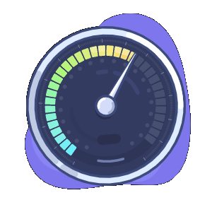
WHAT ARE FEATURES?
MyHome
Electricity Consumption Monitoring
User will get the real time consumption information in the mobile app.
User will get the information such as energy consumption, power consumption, current consumption, bill (in rs).
User can see the bar graph of the consumption.
Using Artificial Intelligence, system can predict the next month bill.
Also, it can be view by using google assistant, telegram and chatbot.

Slide 8

WHAT ARE FEATURES?
MyHome
Air Monitoring
User can see the current indoor Temperature, Humidity and the AQI (Air Quality Index) in mobile app.
Also, it can be view by using google assistant, telegram and chatbot.

Slide 9

WHAT ARE FEATURES?
MyHome
Plant Monitoring
User can see the current moisture level of the plant in mobile app.
User will be notified when the plant needs water.
Also, it can be view by using google assistant, telegram and chatbot.

Slide 10
WHAT ARE FEATURES?
MyHome
Water Tank Monitoring
User can see the current water level of the tank on mobile.
User will be notified when the water tank will be full.
Also, it can be view by using google assistant, telegram and chatbot.

Slide 11

WHAT ARE FEATURES?
MyHome
Fire & Gas Detection
User can check the status in mobile app, whether any fire or gas is detected.
User will be notified when any fire or gas is detected.
Buzzer will also buzz if any fire or gas is detected.

Slide 12
DEVICES [SENSORS/ACUATORS]
MyHome
Esp32 board
4 set of Relays
DHT11 sensor
Flame sensor
Ultrasonic Sensor HC-SR04 sensor
MQ135 Air quality Sensor
Soil moisture sensor with probes
PZEM – 004T 80-260V 100A module

Slide 13
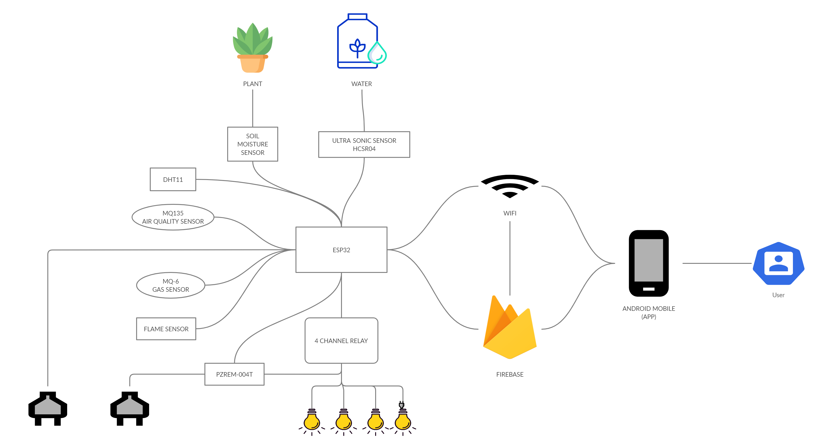
BLOCK DIAGRAM
MyHome

Slide 14
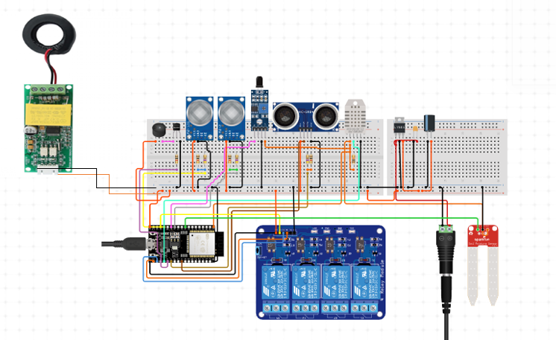
CIRCUIT DIAGRAM
MyHome

Slide 15
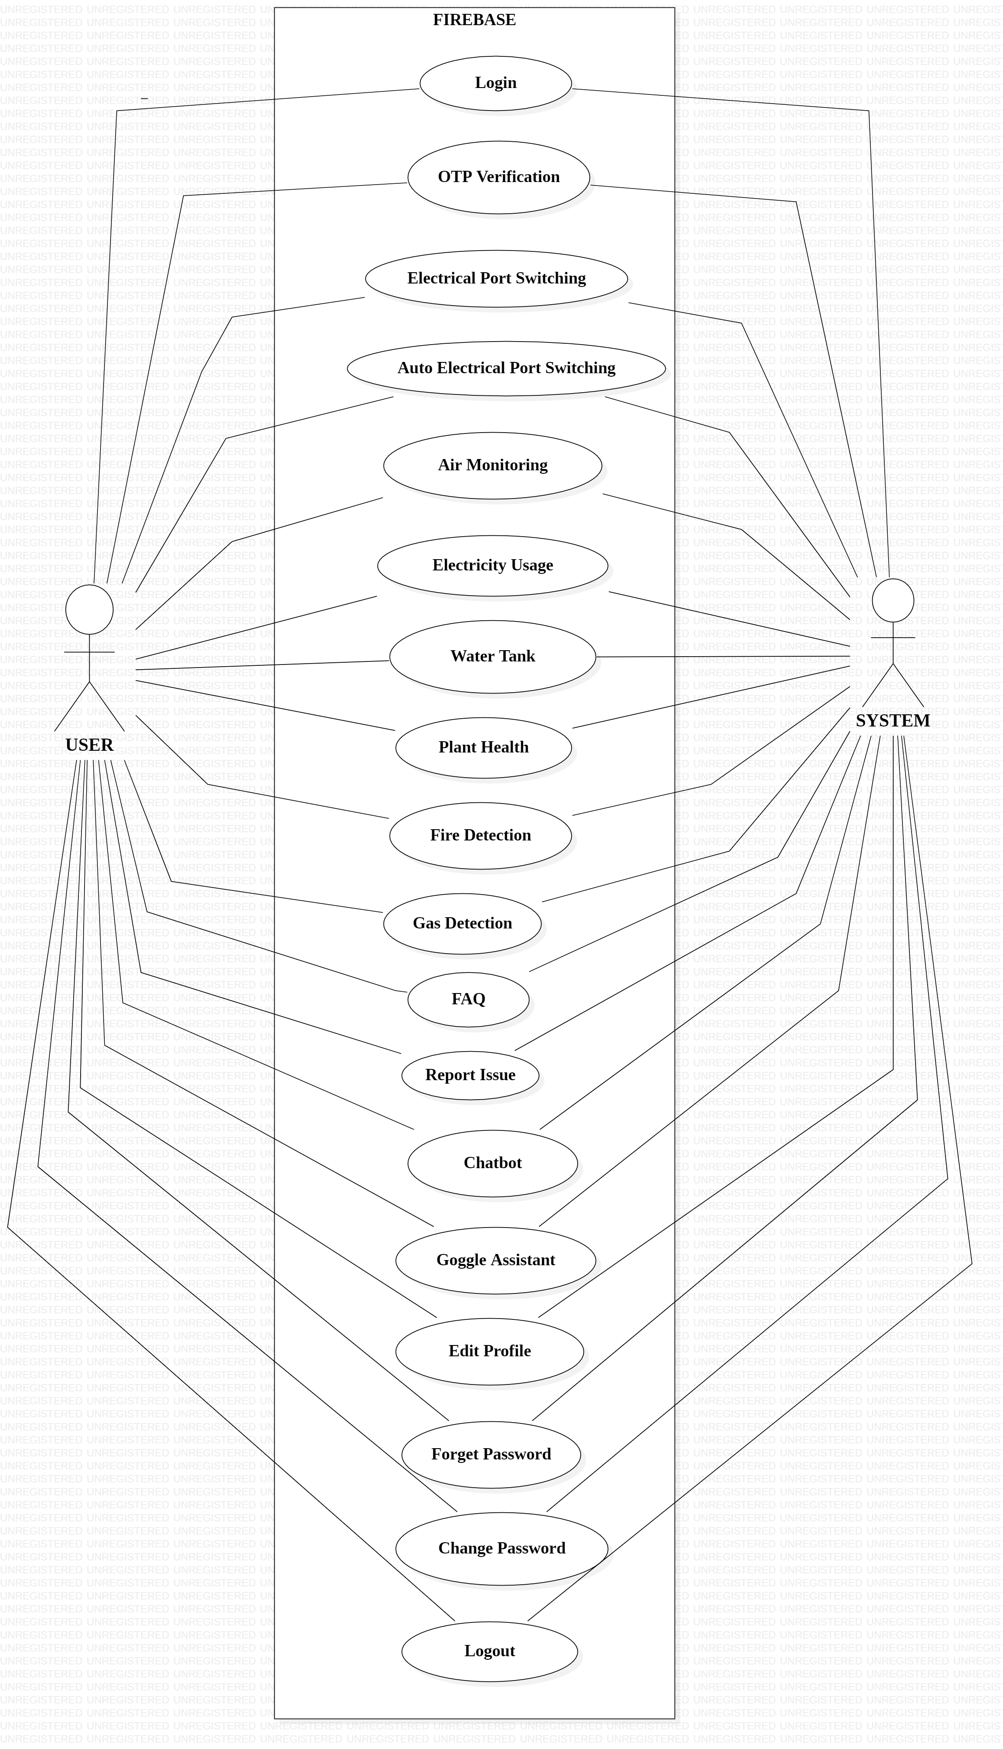
USE CASE DIAGRAM
MyHome

Slide 16
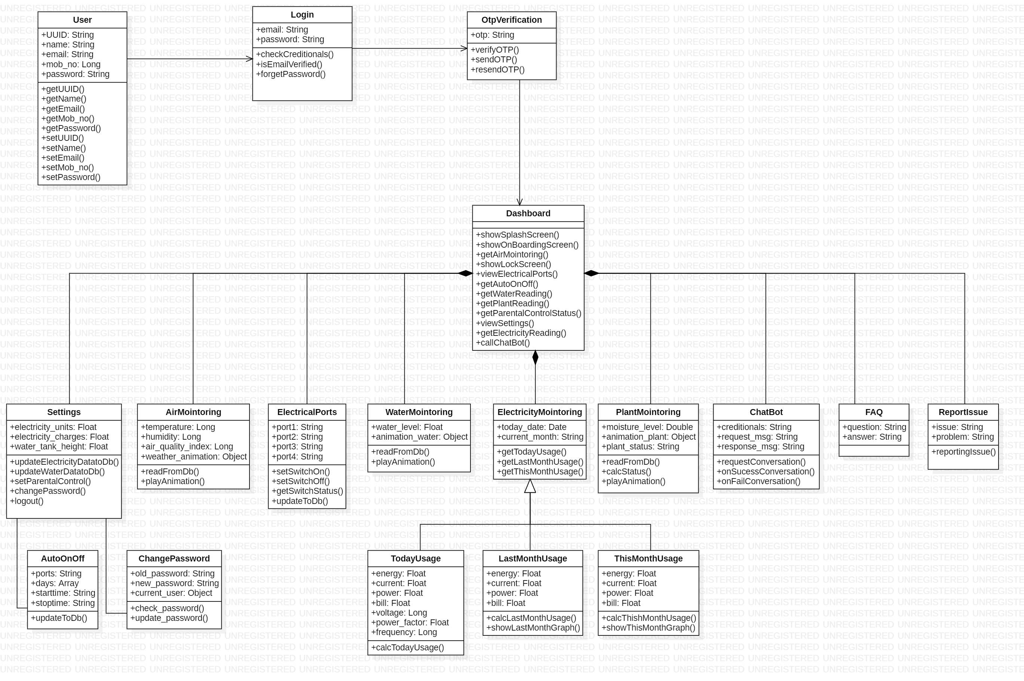
CLASS DIAGRAM
MyHome

Slide 17
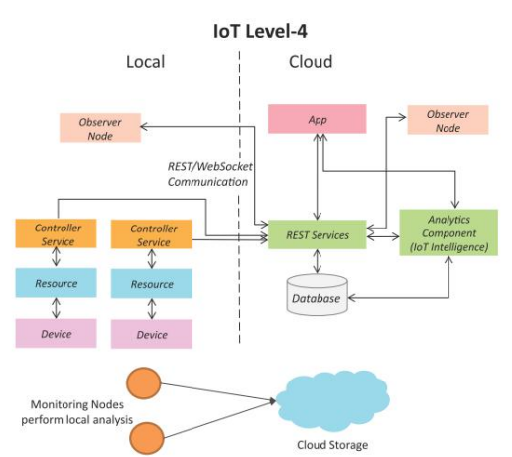
IOT LEVEL
MyHome
A level-4 IoT system has multiple nodes that perform local analysis. Data is stored in the cloud and application is cloud-based.
Level-4 contains local and cloud- based observer nodes which can subscribe to and receive information collected in the cloud from IoT devices.
Level-4 IoT systems are suitable for solutions where multiple nodes are required, the data involved is big and the analysis requirements are computationally intensive.

Slide 18
IOT COST ESTIMATION
MyHome
SR.NO | COMPONENTS | COST
1. | ESP32 BOARD | 500
2. | BREADBOARD FULL SIZE | 100
3. | BREADBOARD HALF SIZE | 50
4. | ULTRASONIC SENSOR | 100
5. | HUMIDITY SENSOR | 75
6. | FLAME SENSOR | 75
7. | JUMPER WIRES [M-M], [M-F], [F-F] | 50
8. | MQ135 SENSOR | 125
9. | MQ6 SENSOR | 100
10. | SOIL MOISTURE SENSOR | 150
11. | BUZZER | 50
12. | PZEM-004T | 1040
13. | 4 SET OF RELAYS | 270
14. | ELECTRICAL SWITCHES & BOARD | 640
15. | CLOUD | 225
TOTAL: |  | 3550

Slide 19
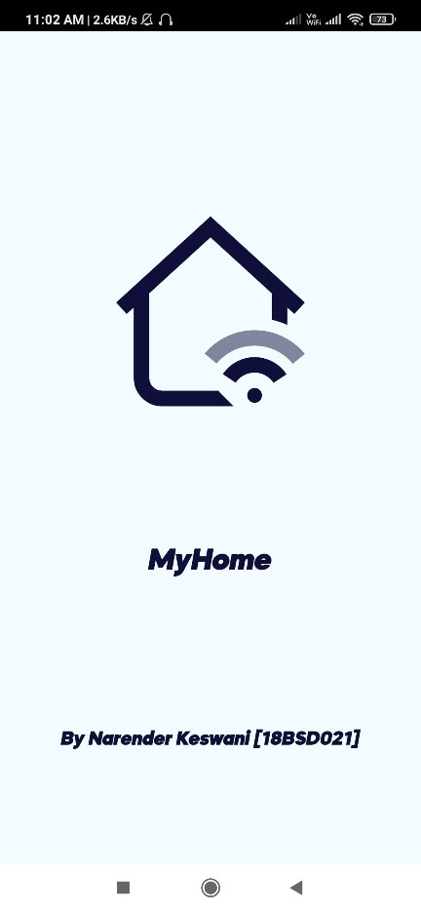
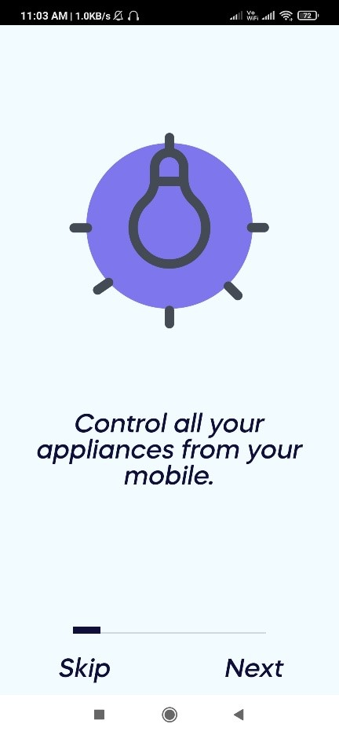
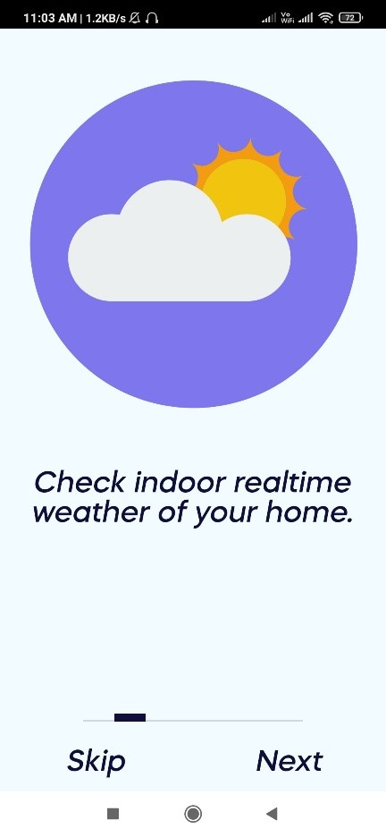
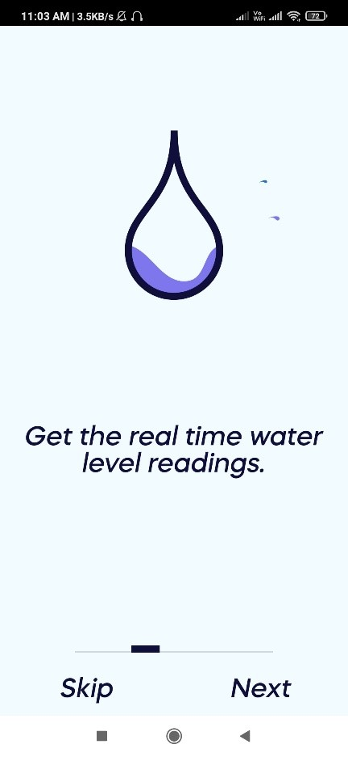
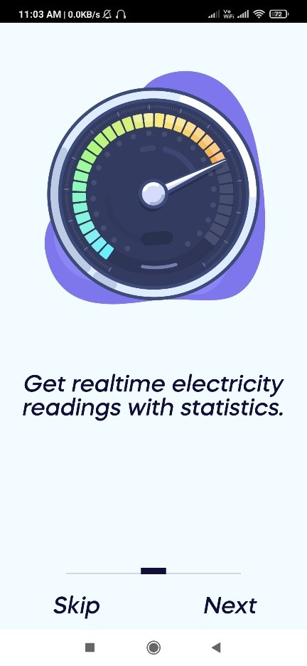
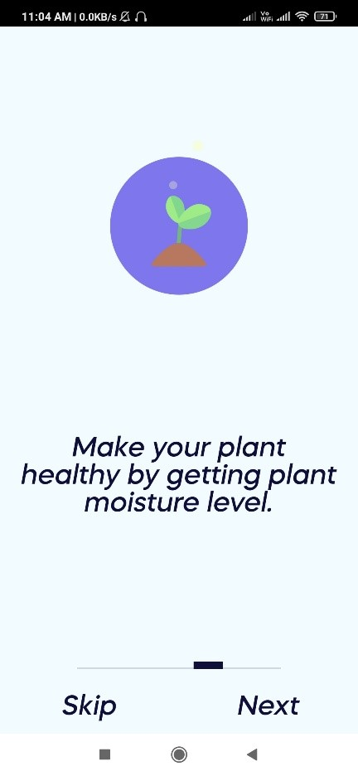
Application Interface Screen Shots
MyHome

Slide 20
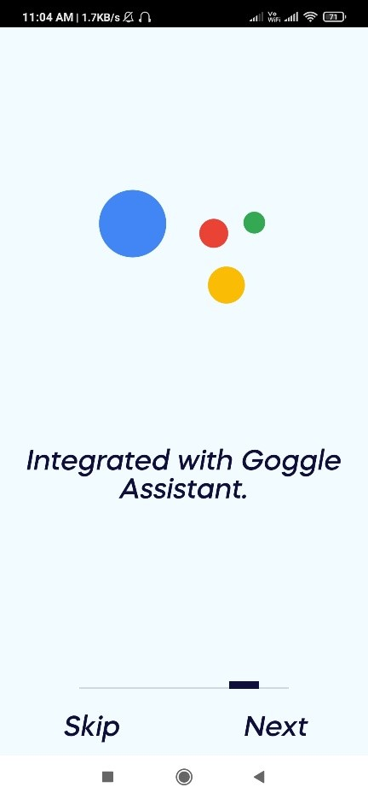
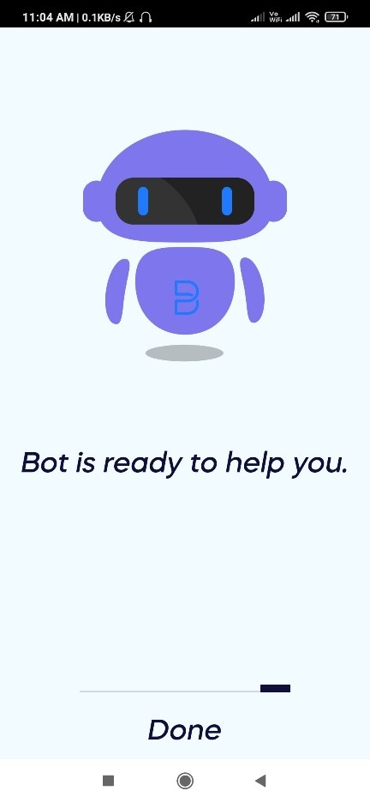
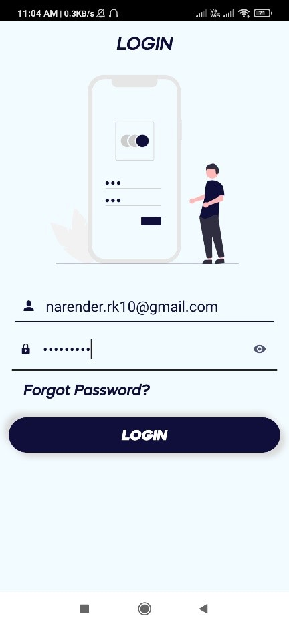
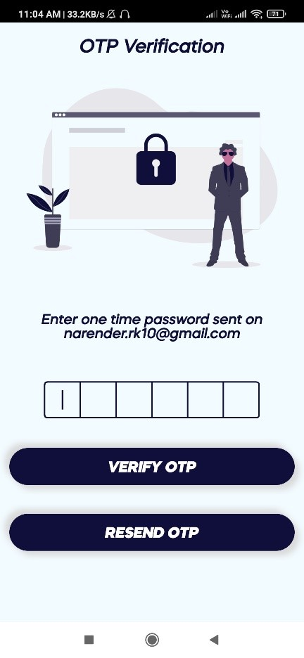
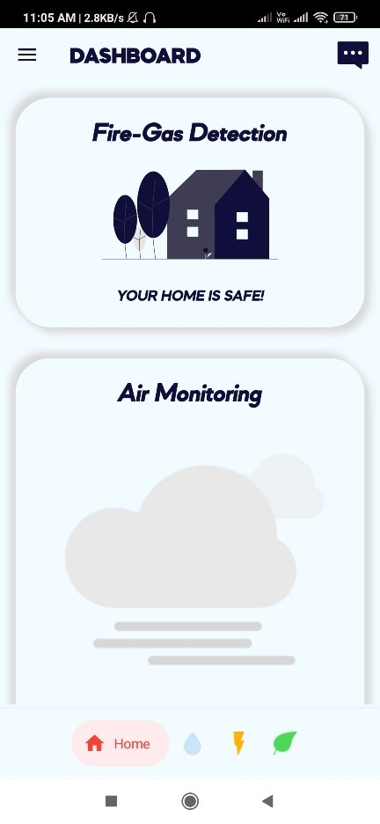
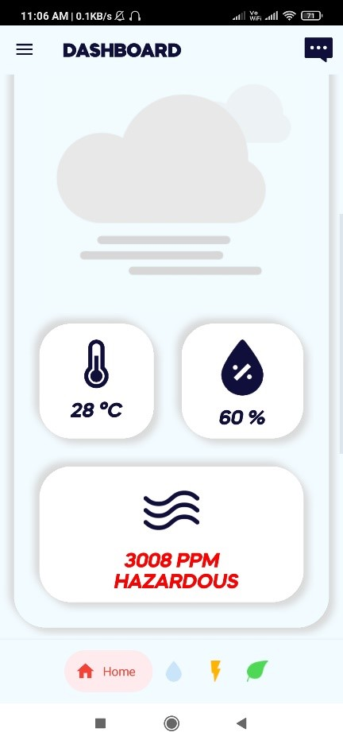
Application Interface Screen Shots
MyHome

Slide 21
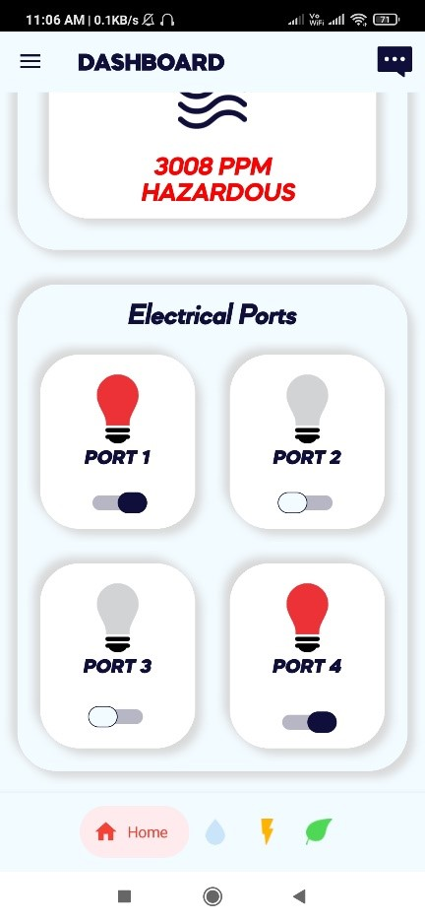
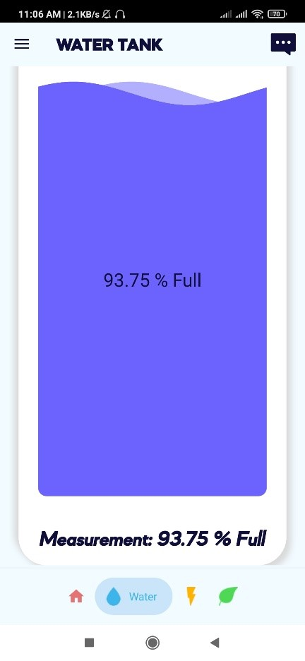
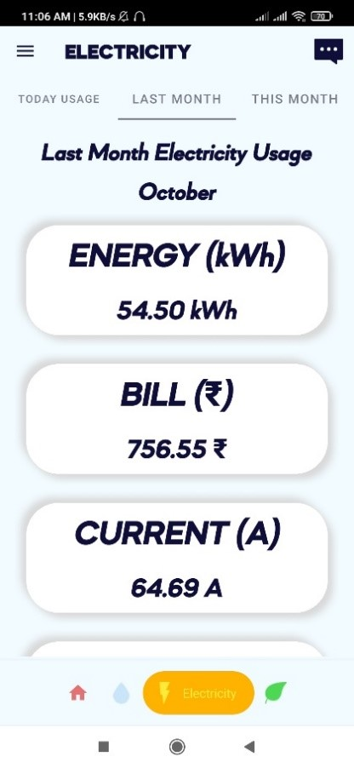
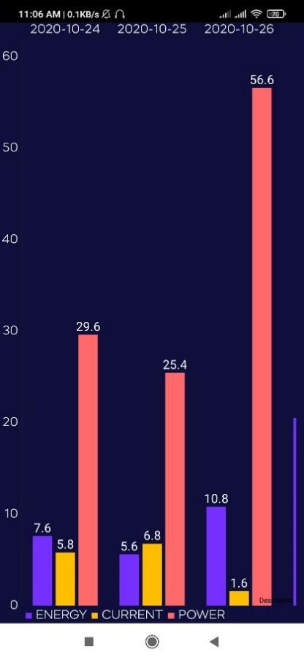
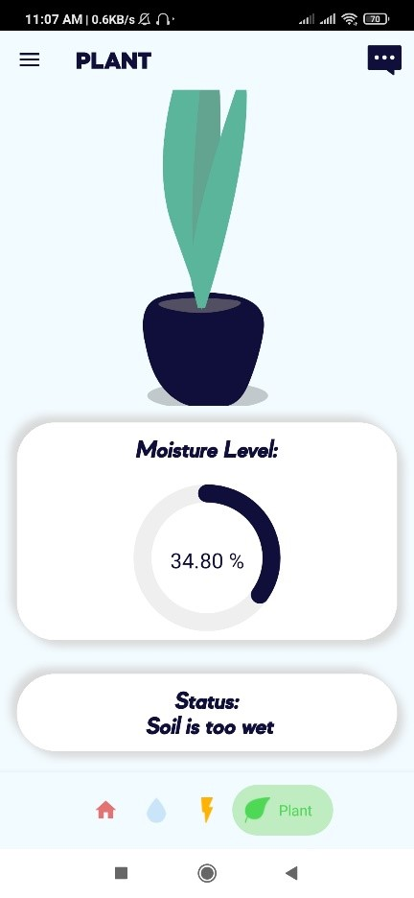
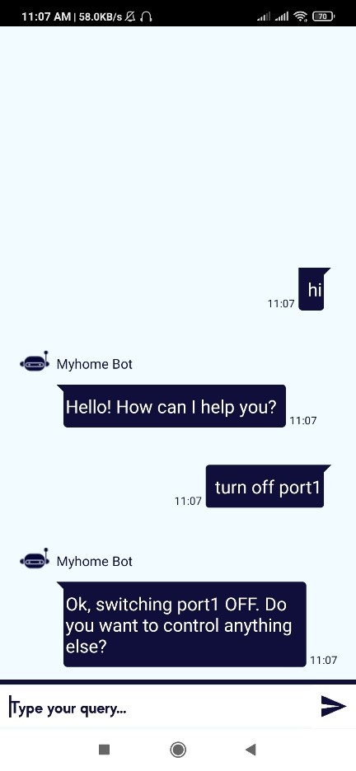
Application Interface Screen Shots
MyHome

Slide 22
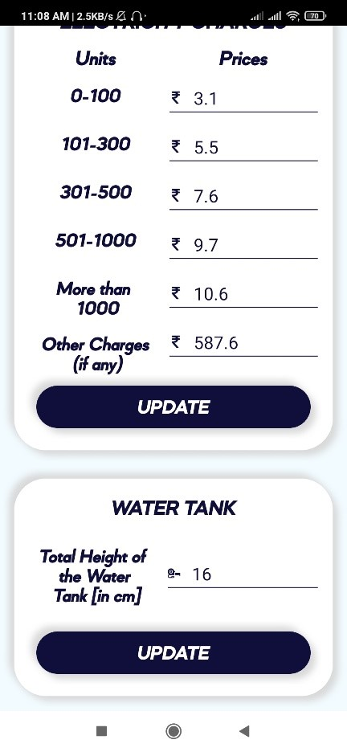
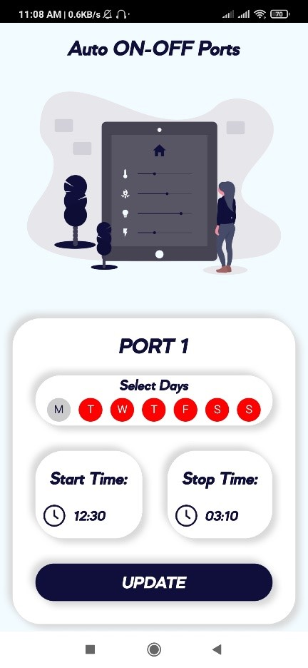
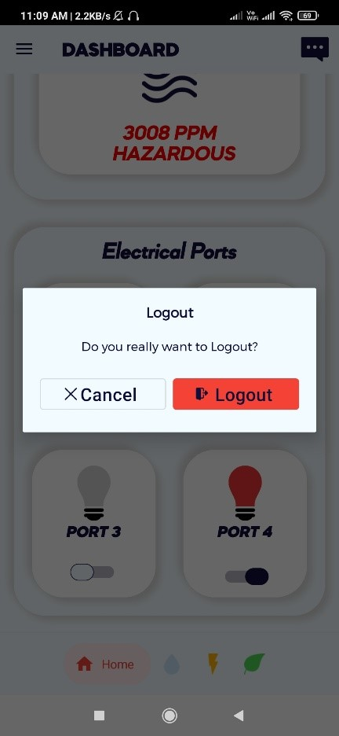
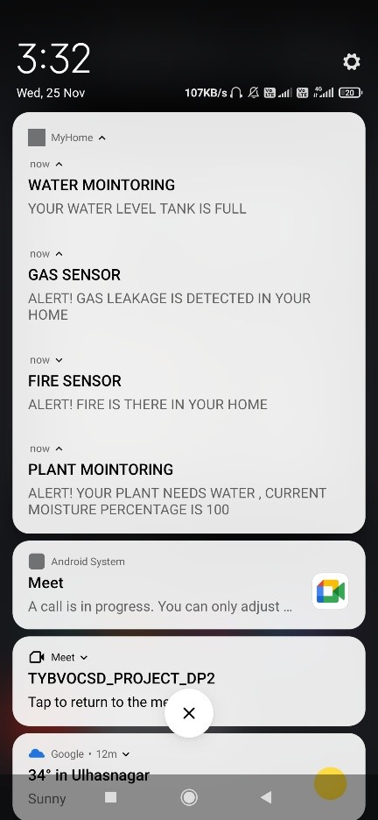
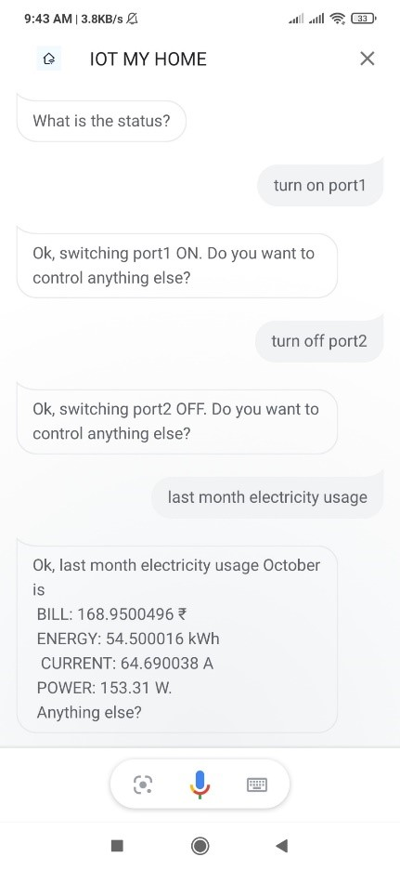
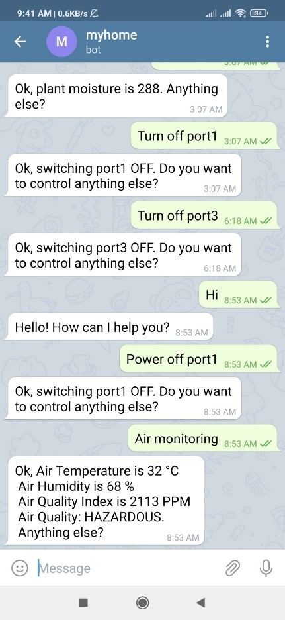
Application Interface Screen Shots
MyHome

Slide 23
Advantages of the System
MyHome
01
Safety
02
Real time monitoring
03
Centralized system
04
Saves Time
05
Ease for Disabled & Senior Citizens
06
Monitor from anywhere
07
Helping in COVID-19

Slide 24
Disadvantages of the System
MyHome
01
Dependency on Internet
02
Dependency on power supply
03
Electronic Circuit Failure

Slide 25
MyHome
LET SEE THE DEMO OF THE PROJECT/SYSTEM

Slide 26

MyHome

